Slide 1

Agenda
9.15 –9.30 Introduction to WISE
9.30 –10.30 WISE Economic module
10.30–11.45 Case studies: Airport expansion and Convention centre
11.45-12.00 EDS Modelling, Recent developments
Tentative Only, Ask Questions!

Slide 2

Waikato Integrated Scenarios Explorer ‘WISE’ - Economic Development Scenarios

Slide 3











Creating Futures
Creating Futures
Developing and applying
planning tools to make informed choices for the future
Programme Leader
Dr Beat Huser
Science Leader
Dr Daniel Rutledge
Dr Liz Wedderburn
OBJECTIVE 1:
Improved communication & deliberation tools,
Dr Daniel Rutledge
OBJECTIVE 2:
Spatial decision support system development

Slide 4
Who is using ISE?
WISE was originally developed for the Waikato Region in the Creating Futures Programme (http://www.youtube.com/watch?v=RgEABCz1RrI)
‘ISE’ models are also being developed in Auckland and Wellington under Sustainable Pathways 2, and in Christchurch under Economics of Resilient Infrastructure
Each version has slightly different sub-modules, but they may be transferred from one version to another

Slide 5
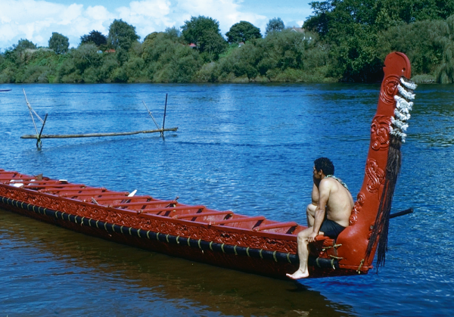
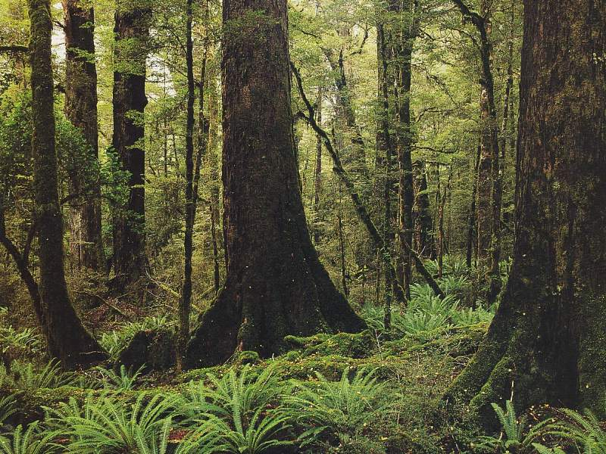
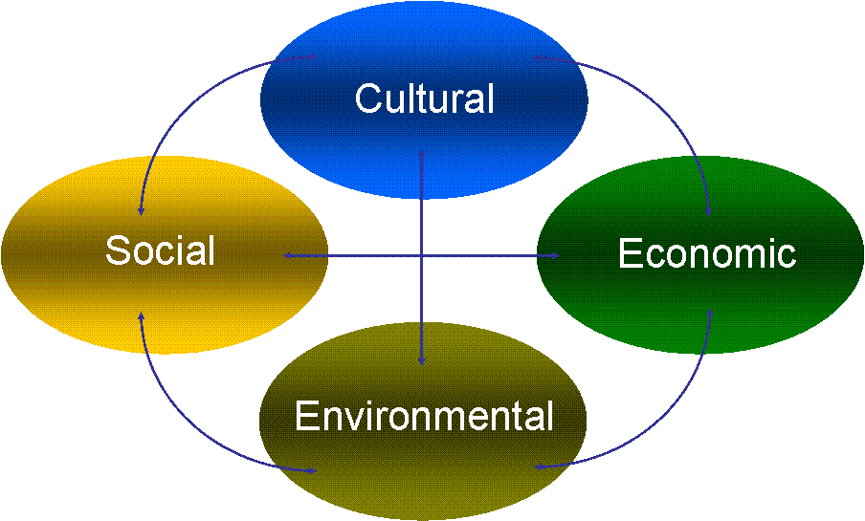
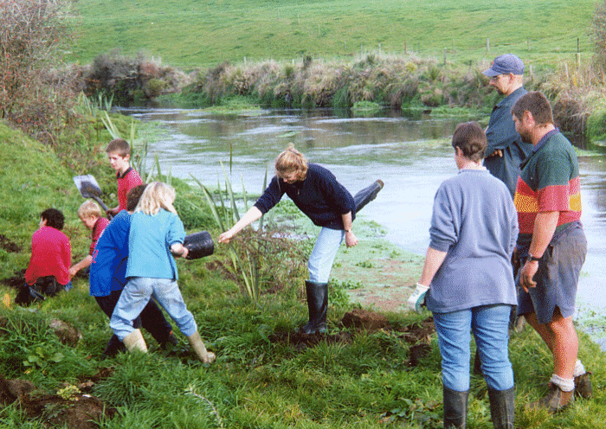
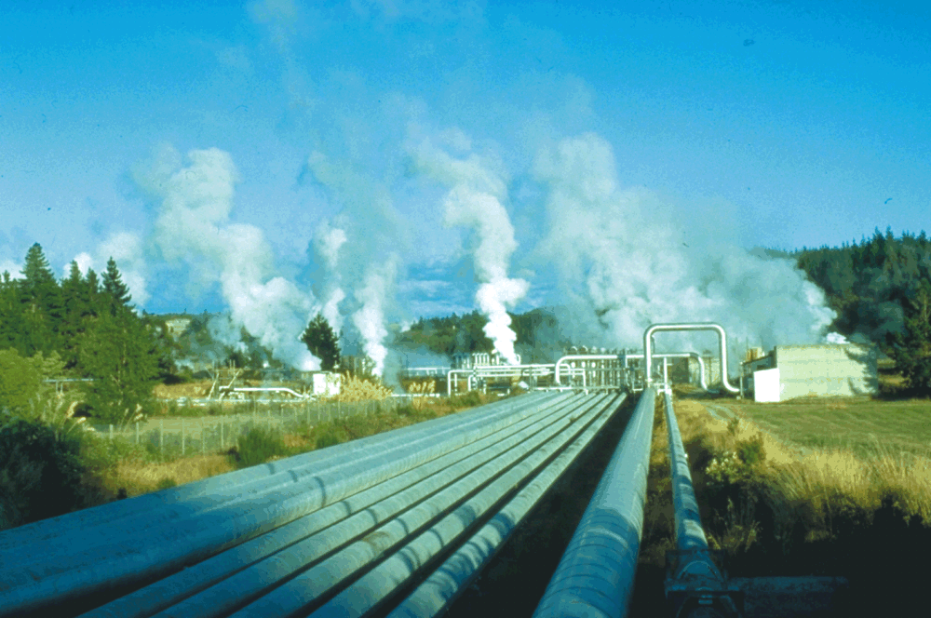

Heading here
Cultural
Environmental
WELLBEING
Social
Economic
Notes:
Source: Dr Beat Huser, Creating Futures Project, 2006-2010

Slide 6
What is ISE?
Goods
Society
Economy
Labour
Wastes
Stewardship
Services
Environment
Resources
Dynamic
Spatially-Explicit
Multi-scale
Notes:
Source: Dr Beat Huser, Creating Futures Project, 2006-2010

Slide 7
Simulating policy options
Recognition
Diagnosis
Problem identification
Design of solutions
Exploration of solutions
Analysis
Evaluation
Selection
Authorization
Value of a policy relevant indicator
Policy
intervention
External event
Policy
intervention
Alternative 1
Alternative 2
Alternative 3
GOAL
Alternative 4
Alternative 5
Alternative 6
Policy
intervention
External event
PAST
PRESENT
FUTURE

Slide 8
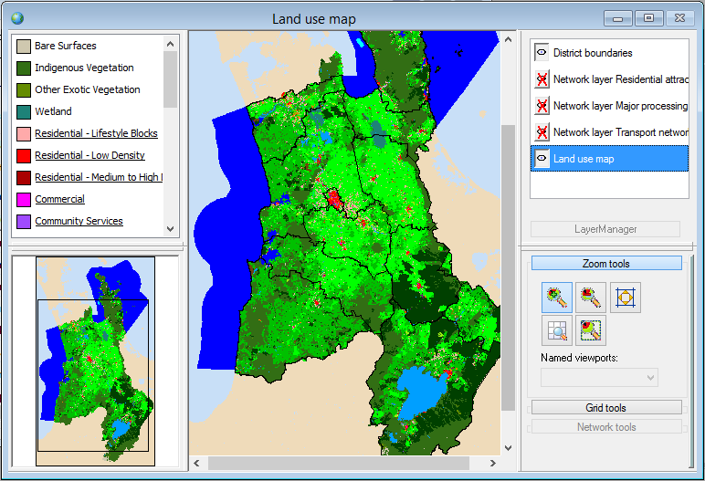
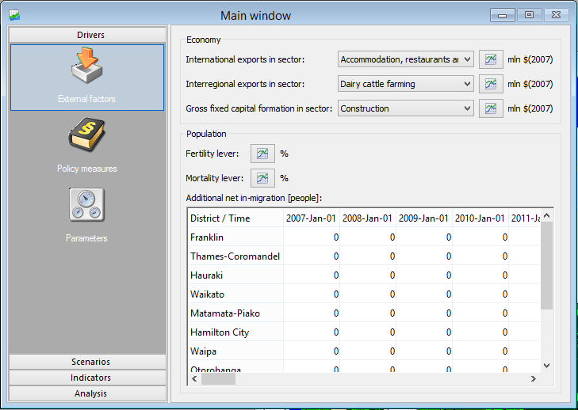
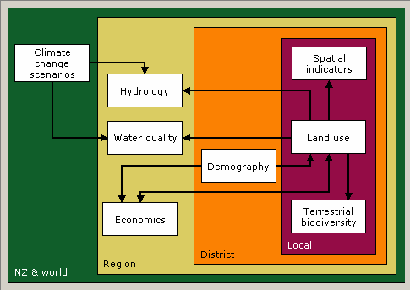
ISE Interface

Slide 9
How does ISE work?
Demand side
t-1
Supply side
* Exports
* Capital formation
Final
demand ($)
Change in final demand ($)
* Population – domestic consumption
Output ($)
Reduction in output ($)
Conversion to land use demands (ha)
Land use allocation
Land that could not be allocated
- Spatial planning
- Suitability
- …

Slide 10
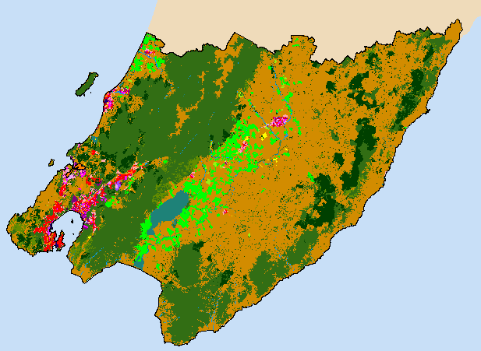
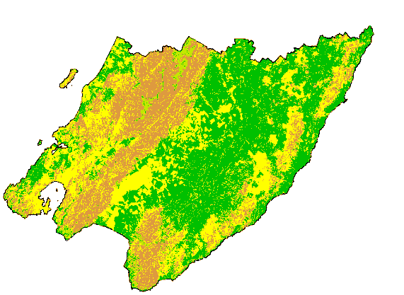
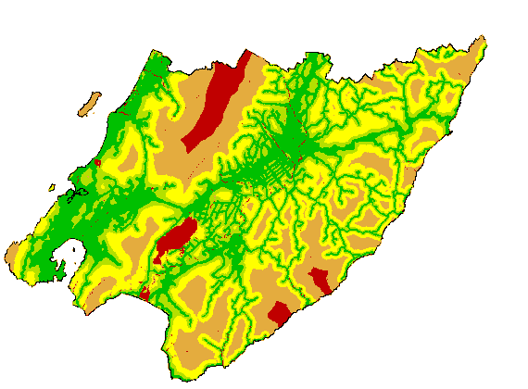
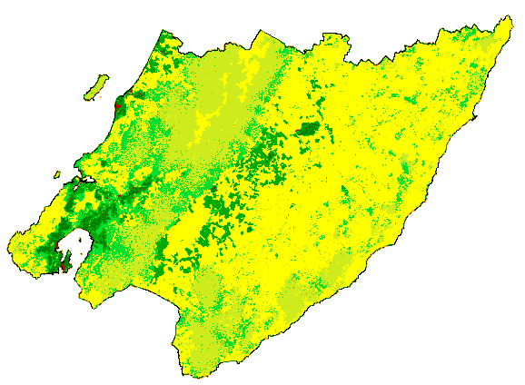
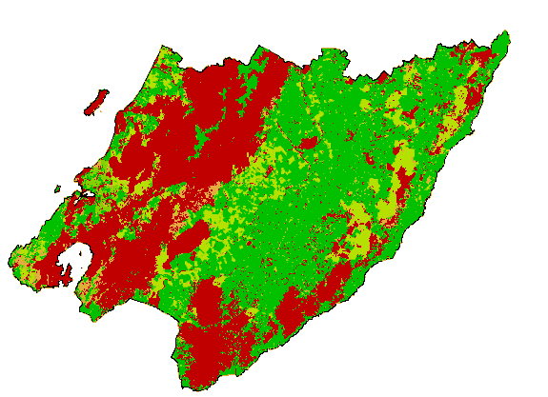
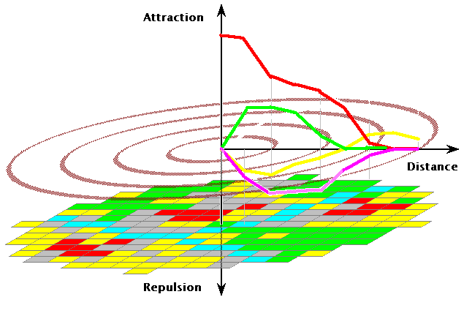
How does ISE work?
Land use
at time T+1
Land use
& interaction weights
Suitability
&
&
Stochastic perturbation
Transition Rule
Change cells to the land use for which they have the highest transition potential until regional demands are met
Time Loop
Accessibility
Transition
Potentials
&
Zoning
=
&
Notes:
Source: Hedwig van Delden, RIKS

Slide 11
What can ISE be used for?
Assessing the socio- economic and environmental impacts of:-
Urban issues
Spatial planning
Understanding the implications of zoning and road/port/airport infrastructure changes e.g. Ruakura inland port, SH1
Residential, business and urban growth strategies e.g. Future proof
Economic development strategies e.g. Waikato EDS
Rural issues
Catchment issues such as N, P loadings and sediment associated with intensive farming e.g. WRISS
Land use change e.g. dairy conversion, carbon forestry

Slide 12
What can ISE be used for?
Policy evaluation
  Quantifying trade-offs of different growth scenarios
  Implications of city form questions e.g. compact versus extended MULs
  Hazard impacts
Spatial Economy
  Business land use and requirements by economic sector
  Residential land use by household type
  Infrastructure delivery
Socio-Economic Impacts
  Future skills demand
  Labour force projections
  Identifies the mismatch between future jobs and skills

Slide 13

Who is using ISE?
ISE was originally developed for the Waikato Region in the Creating Futures Programme (FRST) (http://www.youtube.com/watch?v=RgEABCz1RrI)
ISE is also being developed in Auckland under Sustainable Pathways 2 programme (FRST) (Yr 4 of 6, $3.6m)
A similar model is also being constructed for Christchurch and Auckland under Economics of Resilient Infrastructure programme (MBIE) covering infrastructure outages and natural hazard events (Yr 1 of 4, $2.8m)

Slide 14
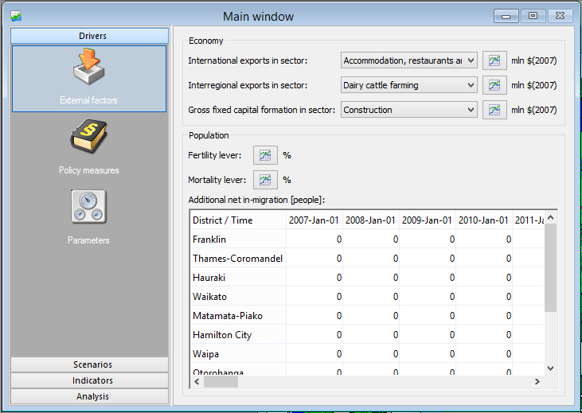
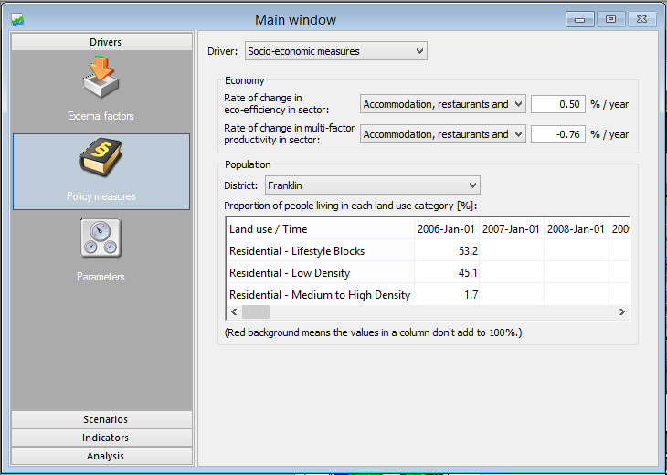
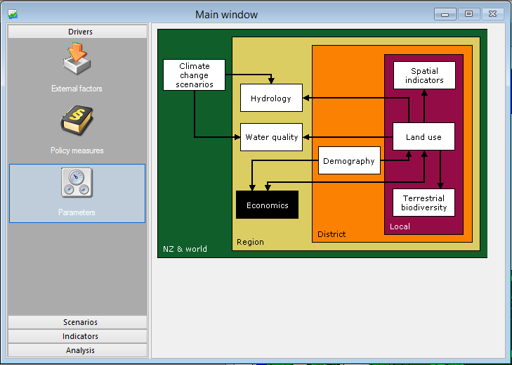
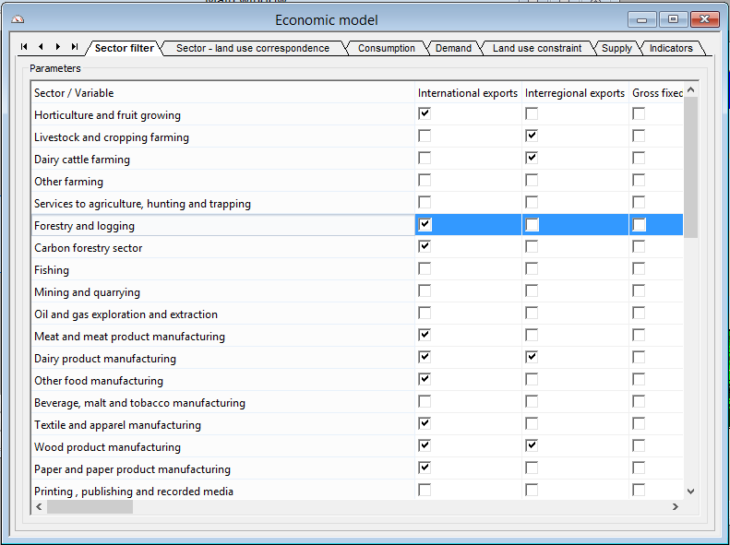
Economic module

Slide 15
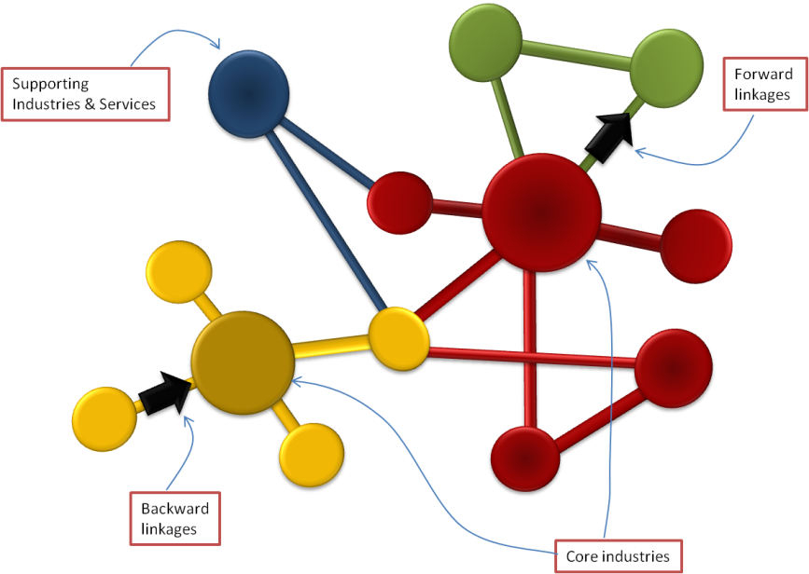
Economic model
Economic
Households
(Consumers)
Gross output
Value added
Employment (FTEs/MEC)
Multipliers
Households
(Labour)
Social
Occupations
Infrastructure requirements
Exports
(Global value chains)
Capital formation
Ecological
Energy use
Emissions (CO₂, N₂O, CH₄)
Solid waste
Land use
Carbon footprint

Slide 16
Economic interdependencies
Industries driven by local demand
Industries driven by intermediate demand
Industries driven by International & other region demand
$281m
$147m
Real Estate
$86m
$99m
$58m
Furniture
Beverages
Svc to Fnn & Ins
$168m
Insurance
$144m
$91m
Ptrlm
$89m
$33m
Cultural & Recr
$377m
Wholesale
$52m
$73m
$274m
$1,071m
$219m
$134m
Communic.Srvcs)
$113m
Business Serv
Textile & Apparel
Mach & equip
$112m
$256m
$159m
$84m
$103m
Strct
Water supply
Non-metllc
$173m
$188m
$147m
$515m
$30m
Air trns
$103m
Rub, Plst
$243m
$108m
$69m
Basic metals
Print, pub & rec media
$175m
Transp Equipmt
$59m
$95m
$84m

Slide 17
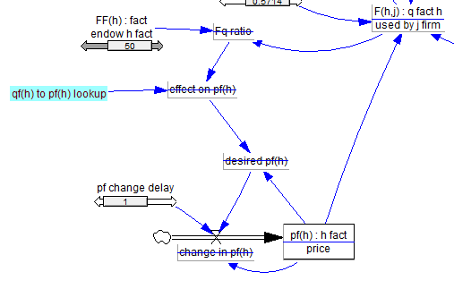
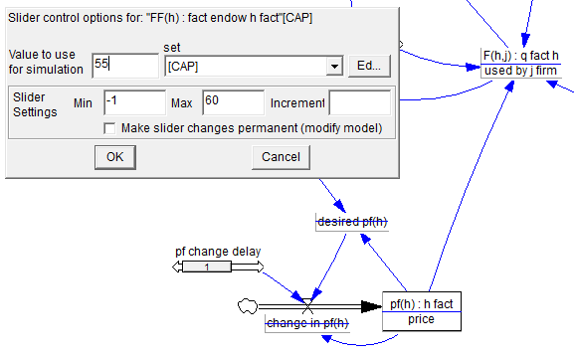
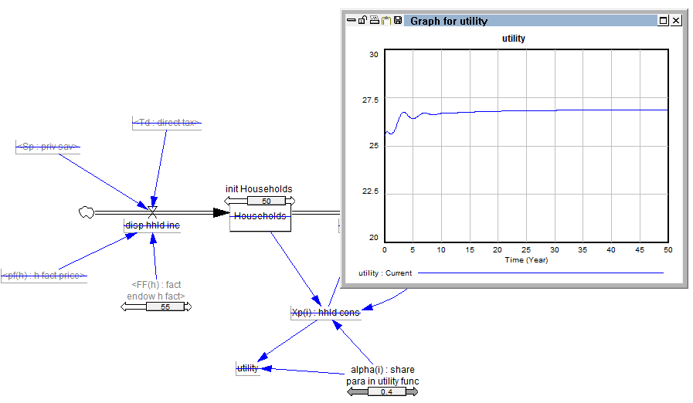
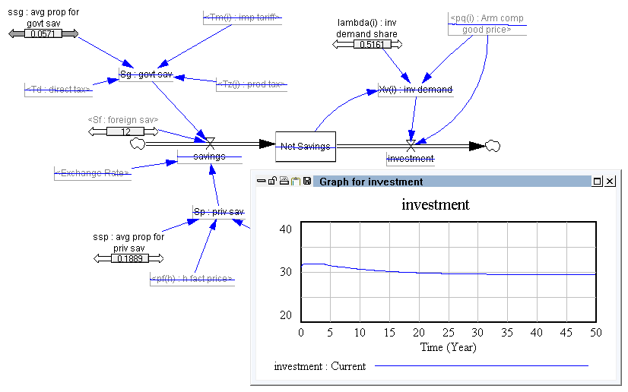
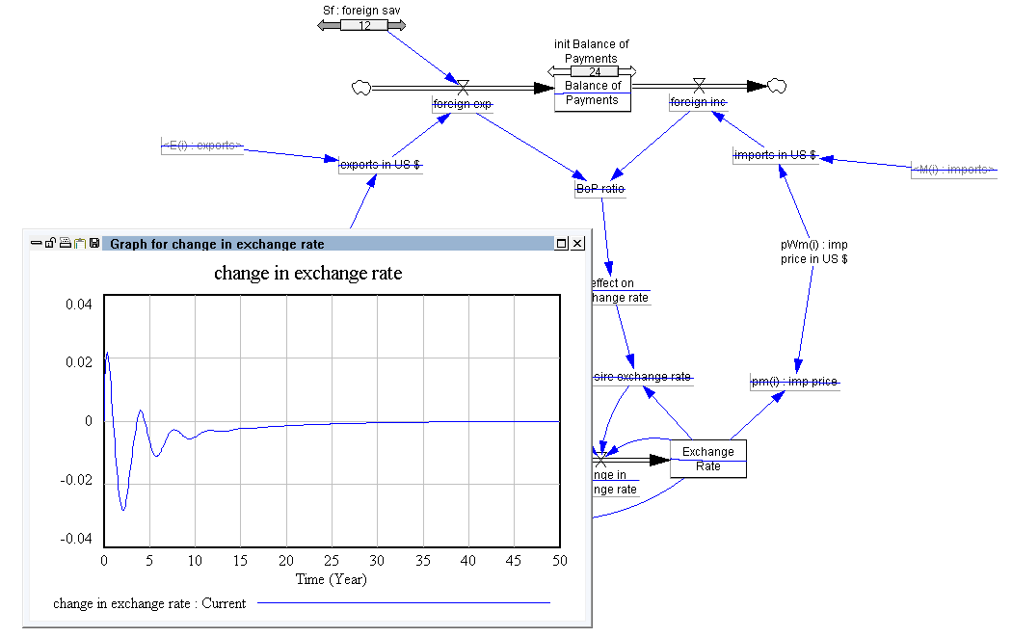
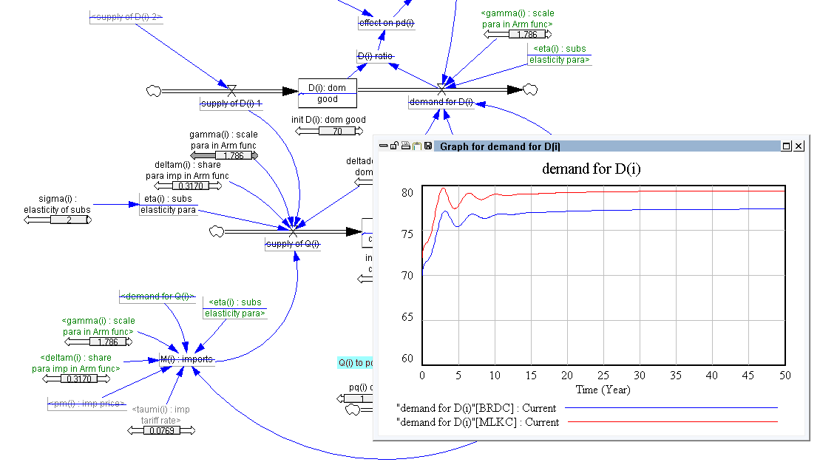
Dynamic economic model

Slide 18
Eg1: Airport expansion scenario
Expansion of airport to enable international flights (Airbus 350, 787 Dreamliner)
This would enable people to fly directly into Hamilton via several international destinations throughout the Asia Pacific region
Initially 4 to 5 flights per week (9,500 NZR departures and 14,000 overseas visitor arrivals), within 3 years 14,500 NZR departures and 19,000 overseas visitor arrivals)

Slide 19
Main impacts
Overseas visitors increase by 19,000 with total direct value added estimated at $12.3m per year, comprised of $2.6m hospitality, $3.9m wholesale and retail, $1.5m culture and recreational srvcs, $3.0m air transport & $1.3m road transport
International students increase from 2,000 to 4,000 then additional $14m per year
Total cost $300m, direct $80-100m investment coupled with LG/CG investment of $200m

Slide 20
Economic Impacts
A value added impact of between $₂₀₀₆16m and $₂₀₀₆18m per annum from 2016 through 2031. Or, put alternatively, 0.14% of total Waikato value added.
An average increase in direct and indirect employment of 393 jobs per year (MECs), or 7,290 job years for the period 2016 to 2031

Slide 21
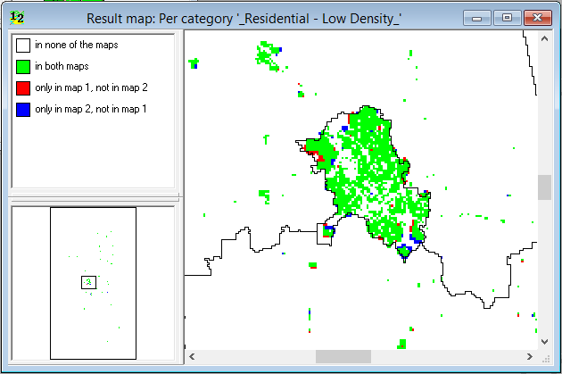
Land use change BS vs AE, 2031

Slide 22
Eg2. Airport & Convention Centre Scenario
Proposed convention centre
  Build cost of $120m
  Operational cost of $40m per year
Assumptions
  Build is funded through FDI
  All operational costs are net additional i.e. no displacement or transfer effects
  Overseas tourists expenditure increases by 30% above airport expansion scenario

Slide 23
Economic Impacts
Direct and indirect value added contribution of $₂₀₀₆64m based $₂₀₀₇40m + CAGR 0.5% pa ongoing operational expenditure
Direct and indirect value added contribution of $₂₀₀₆100m associated with the $₂₀₀₆120m construction build
Approximately 1850 jobs p.a. created. Or, put alternatively, 0.7% of employment in 2025.

Slide 24

Land use change BS vs AE & CC, 2031

Slide 25
Modelling Economic Development
Integrated scenarios are complex to setup, requiring knowledge of all ISE modules
Economic impact should be net of the next best alternative, not net of the baseline – as there may be opportunity costs
Both costs and benefits must be modelled; many EIAs only model capital and operational expenditures – but, there are costs associated with funding, displacements, transfers

Slide 26
Waikato EDS and ISE
Socio-economic and environmental implications of proposed growth strategies
  Definition of key sectors driving the economic development
  Interpretation of what economic growth is required to meet EDS goals or targets under different scenarios
  Analysis of growth scenarios using ISE over the next 20-30 years
ISE allows us to consider, in an integrated way, the economic, social (employment, skills) and environmental (land use, water, energy, emissions) tradeoffs of the EDS

Slide 27
EDS Analytical Process
Stage 1: Establish baseline
Step 1: Establish Database
Step 2: Establish Major Industry Trends & Prospects
Step 3: Baseline Results & Key Sectors
Setup ISE baseline
B
Drivers of change (dom & exp)
C
Inter-dependencies
D
Other data (inhibitors, enablers)
A
Base yr ind/com DB
E
Sectors of interest
Stage 2: Scenario development & refinement
Develop scenarios (Client driven)
Interviews (Captains of Industry)
Capture industry growth perceptions
Additional model runs and scenario analysis
Setup ISE alternatives
Stage 3: Scenario modelling & results
Implications of alternative scenarios
Implications and impacts

Slide 28
Growth Goals
 | Goal Name | Description
a) | 20 in 20 (OECD) | Gain 20 places in the OECD rankings in 20 years (by 2031).
b) | Top 10 in the South | Auckland to be in the top 10 cities in the southern hemisphere by 2031.
c) | Third in Australasia | Auckland to be in the top 3 cities in the Australasia by 2031.
d) | Top 10 in the ASEAN | Auckland to be in the top 10 cities in the ASEAN cities by 2031.
e) | 2025 Task Force | NZ to have living standards that is comparable to Australia by 2025.
f) | Top half of OECD | New Zealand to be in the top half of the OECD by 2031.
g) | 20% better than Historic | Auckland grows 20% faster than in the past.
h) | Top 10 in 20 | Auckland to be placed in the top 10 OECD rankings in 20 years (by 2031).
i) | Top in the South | Auckland to be the top city in the southern hemisphere by 2031.
j) | 20 in 20 (Demograhia) | Gain 20 places in the Demographia rankings in 20 years (by 2031).

Slide 29
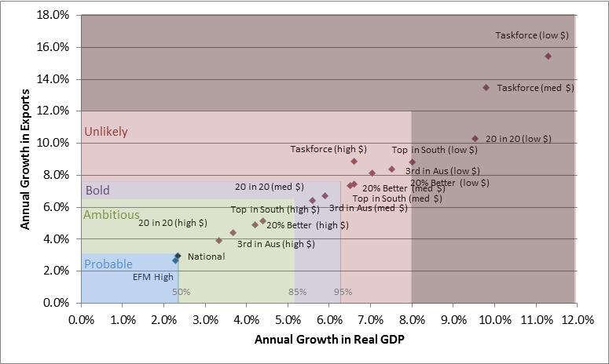
EDS Growth Goals

Slide 30
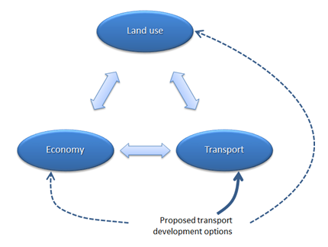
ISE Recent Developments
Dynamic economic model (Dec 2013)
Activity-based land use change model – AC and GW, CCC (Jun 2014)
Integration of land use, economics and transport (Sep 2013)

Slide 31
Transport module
National / Regional spatial claims
National / Regional spatial claims
Zoning
CA-Spatial interaction model
Land suitability
Zoning
Cellular Automata land use model
Production & Attraction
Accessibility
Land suitability
Simple
Transportation model
Exogenous Land use
Production & Attraction
Accessibility
Distribution & Modal split
Distribution & Modal split
Travel costs & Accessibility
Route choice & Allocation
Travel costs & Accessibility
Route choice & Allocation

Slide 32
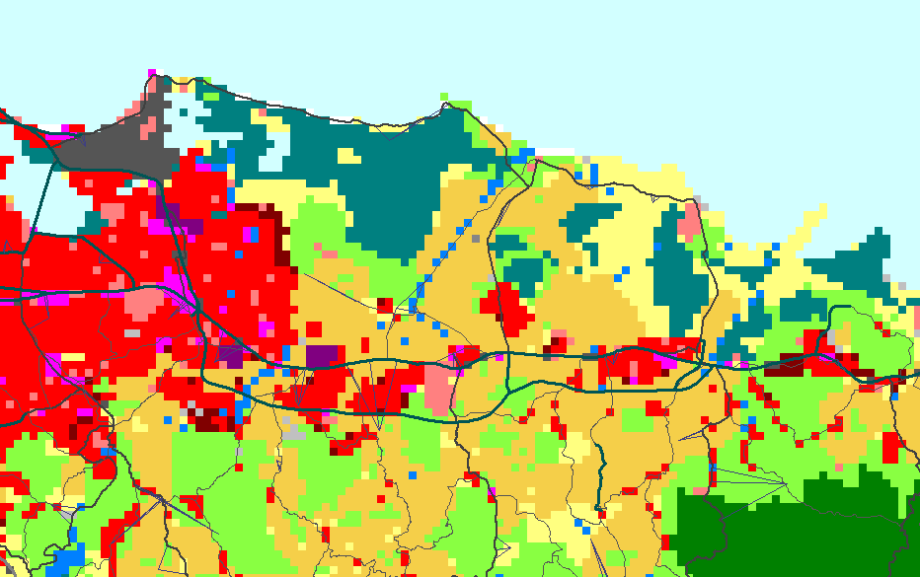
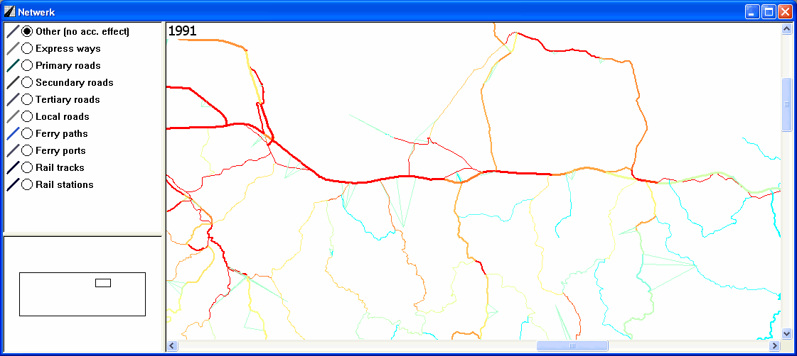
Eg. Construction of Highway
2015 – PR66
Notes:
Source: Hedwig van Delden, RIKS

Slide 33
Activity based approach
Model activity and land use separately
Land use and activities are mutually influential
More than one activity in one location

Slide 34
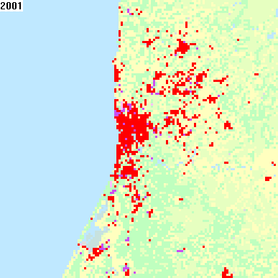
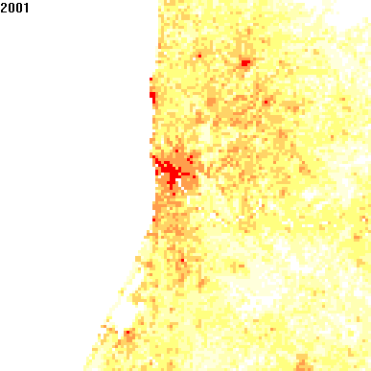
Activity based approach
Land use
Population

